Slide 1
Online Examination System (C Programming Project)
Course Code: CSEG1041
Submitted By:Thammineni Nikhil
SAP ID: 590027800
Submitted To: Dr. Prashant Trivedi
University of Petroleum and Energy Studies

Slide 2
Introduction
This project is a simple command-line based online examination system written in C.
It allows users to register, log in, and attempt a multiple-choice exam.
The program demonstrates concepts of modular programming, file handling, functions, and decision-making.

Slide 3
Objectives
To create a functional examination system using basic C programming.
To implement registration & login using file storage.
To design an MCQ exam system with scoring.
To use multiple modules (.c / .h files) for clean coding.

Slide 4
Project Features
User Registration
User Login
(credentials stored in users.txt)
5 Multiple-Choice Questions
Score calculation
Modular code with separate files
Simple and beginner-friendly structure

Slide 5
System Architecture / File Structure
main.c → menu + control flow
exam.c/.h → exam questions + scoring
user.c/.h → register + login (file handling)
utils.c/.h → helper functions (clear screen)
users.txt → auto-created for saved users
Flow: Register/Login → Start Exam → Calculate Score → Display Result

Slide 6


Flowchart
Start Exam
Begin the assessment
Login Success?
Decision: proceed or error
Register / Login
User authentication entry
Show Menu
Display options to user
(You can insert a simple flowchart image)

Slide 7
Core Concepts Used
Functions in C
Header files (.h)
File Handling (fopen, fprintf, fscanf)
Conditional statements
Switch case
Modular Programming
Loops and input handling

Slide 8

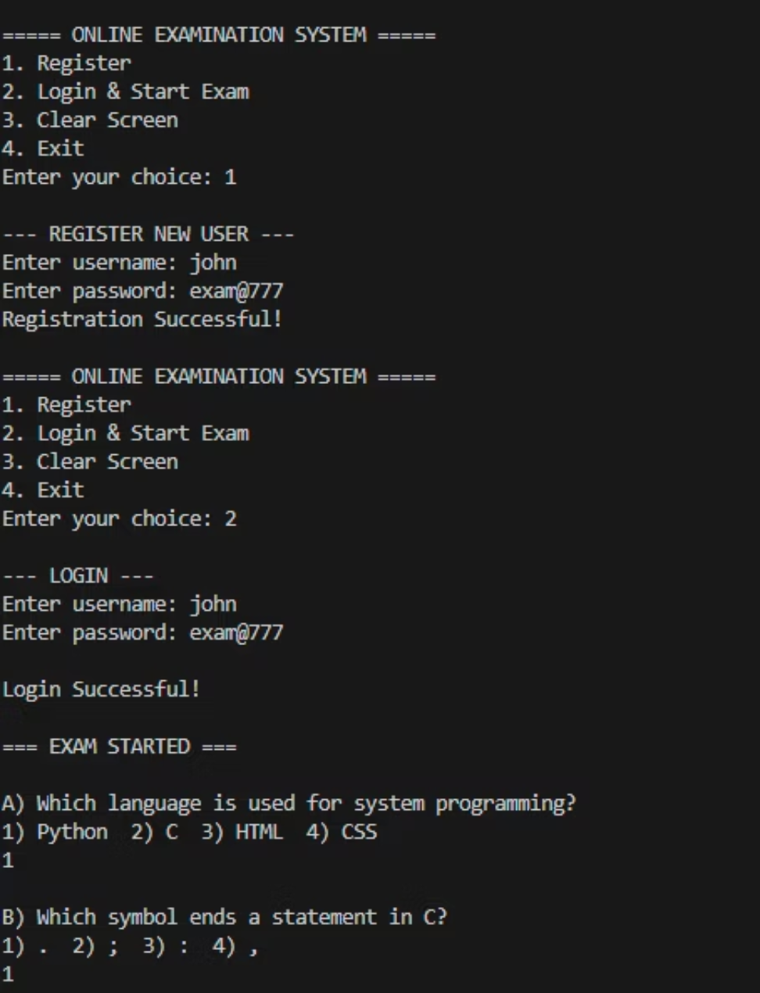
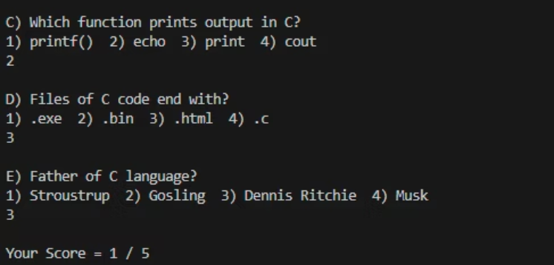
Code Snippets (Screenshots)
registerUser()
loginUser()
startExam()
main menu in main.c

Slide 9
Output / Testing
Test Cases:
Register user → Success
Login (correct) → Allowed
Login (wrong) → “Invalid username/password”
Exam attempt → Score out of 5

Slide 10
Conclusion & Future Work
Conclusion:
Future Enhancements:
Successfully implemented an exam system using C.
Admin panel
Learned file handling, functions, modular coding & menu-driven programs.
Add question bank from file
Timer-based exam
REFRENCE:
Randomized MCQs
Store scores for all students
chat gpt
gemini
college wallah

